Slide 1
Pancake Flipping
Competition - Best flipper award

Slide 2
ASSUMPTIONS
Each day indicates one match for 50 days
Hand selection proportion 70% and 30% for 1st and 2nd preferred hands respectively
No compulsion on which hand to use as long as it is under above proportion for each match
Best flipper should be based on both the hand performance
Award to be given to only one of the performer
Name | Preferred hand
 | 1st | 2nd
Arielle | Right | Left
Boris | Left | Right

Slide 3
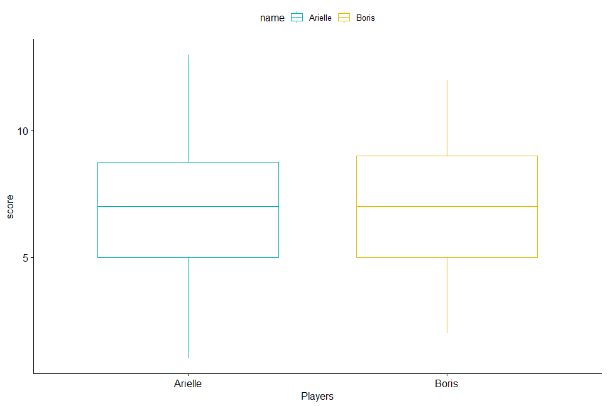
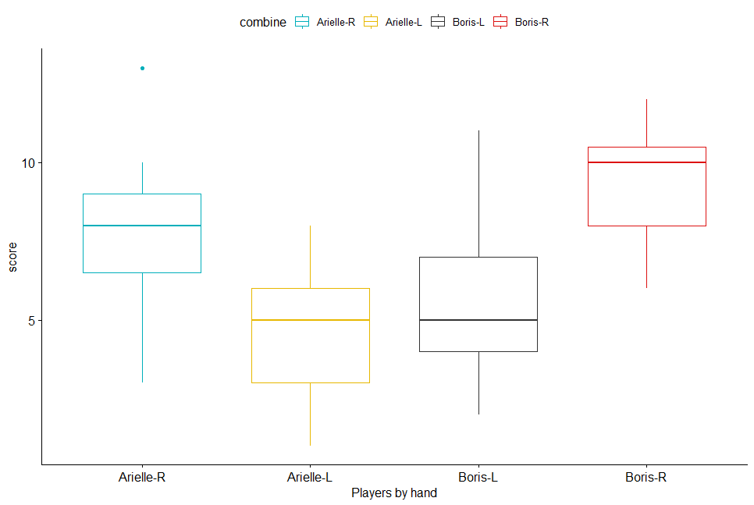
Arielle vs Boris – Best flipper
ARIELLE | BORIS | DRAW
46% | 46% | 8%
name | hand | Matches | Attempts | Total Score | Avg Score | med | min | max | var | std | prop
Arielle | L | 15 | 300 | 72 | 4.8 | 5 | 1 | 8 | 4.2 | 2.0 | 0.3
Arielle | R | 35 | 700 | 269 | 7.7 | 8 | 3 | 13 | 4.5 | 2.1 | 0.7
Boris | L | 35 | 700 | 199 | 5.7 | 5 | 2 | 11 | 4.8 | 2.2 | 0.7
Boris | R | 15 | 300 | 139 | 9.3 | 10 | 6 | 12 | 3.1 | 1.8 | 0.3
1st
2nd
Out of 50 matches, each won 46% and drew 8% of matches
Both has won equal matches which will have supporters for both equally
Comparing the scoring ratio between two, we don’t find significant evidence in overall to draw a conclusion
Comparing 1st preference and 2nd Preference for both with significant evidence
1st Preference Result:
Based on all evidence, Arielle is very good when he is using the Right hand
2nd Preference Result:
Based on all evidence, Boris is very good when he is using the Right hand (2nd Preferred)
Notes:
Assumptions:

Slide 4
Conclusion
Win Contribution %
Match Contribution %
Arielle win Contribution %
Boris win Contribution %
Name / %win | 1st Preferred | 2nd Preferred
Arielle | 78.3% | 21.7%
Boris | 47.8% | 52.2%
Match Contribution % |  | Boris
 | Preference | 1st | 2nd
Arielle | 1st | 44% | 26%
 | 2nd | 26% | 4%
Arielle Win Matrix % |  | Boris
 | Preference | 1st | 2nd
Arielle | 1st | 68% | 23%
 | 2nd | 38% | 0%
Boris Win Matrix % |  | Boris
 | Preference | 1st | 2nd
Arielle | 1st | 18% | 77%
 | 2nd | 54% | 100%
We got conclusive evidence that
Arielle is fully dominated when he is using 1st preferred hand (Right) and less contribution from other hand
Out of 4 combinations, Arielle majorly scored on 1st preferred hand and comparatively less in other parts
Boris is very strong when he is using 2nd Preferred hand (Right)
Though Boris contribution is less in 1st preferred hand but his performance is reasonably good across all the combination
Those I conclude saying that,
“BORIS is the better Pancake Flipper”

